Slide 1

BITCOIN
An Introduction

Slide 2
What is Bitcoin / Crypto Currency ?
Non Centralized, unbacked Mathematical Algorithm that is Digitally exchangeable over a peer to peer network.

Slide 3
What is Bitcoin / Crypto Currency ?
In ENGLISH!
Mathematical code that can be exchanged as money between trusted partners.

Slide 4
What is Bitcoin / Crypto Currency ?
https://www.youtube.com/watch?v=cFj72hrUZt4&t=215s

Slide 5
History
In January 2009, the bitcoin network came into existence with the release of the first open source bitcoin client and the issuance of the first bitcoins, with Satoshi Nakamoto mining the first block of bitcoins ever (known as the genesis block), which had a reward of 50 bitcoins.

Slide 6
History
Satoshi Nakamoto?
Did he exist?
Pseudonym
SAmsung, TOSHIba, NAKAmichi MOTOrola?

Slide 7
How to make a bitcoin
Mining
Decoding a complex mathematical formula (generally using Video rendering cards)
Only 21 million will ever be made
Over 16 million mined so far
Decreasing numbers every year.
Divisible up to .00000001

Slide 8
How to make a bitcoin
https://www.youtube.com/watch?v=7yCqWO3gZvQ

Slide 9
How to by a Bitcoin
Download the app "Coinbase."
Create a Coinbase account.
Now you're logged in. Look at daily volatility!
Add a payment account.
You're ready to buy. Tap the Buy button again.
You can also buy Ethereum.
Prepare for the fraud prevention call. ...

Slide 10
What can you buy?
Dark Web Discussion
Real Estate
Gold Strike (all MGM) Casinos
Microsoft, Dell, DISH Network, Overstock, Newegg (IT stuff), TigerDirect, cheapair.com, UK Theater tickets, college degree, brandy distillery, Pizza (Dominos), Most Airline tickets
More added DAILY

Slide 11
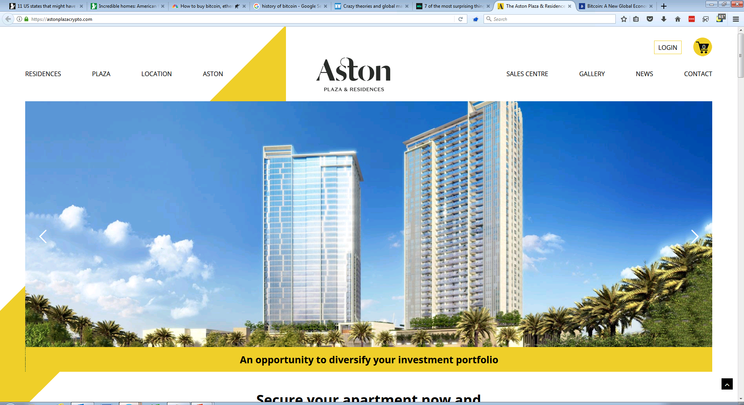

Slide 12
Risk
Peer to peer reviewed
Only worth what ppl pay
Can be supplanted by other currencies (myspace / napster)
Not always backed up
Transactions are nearly always irreversible

Slide 13
Dennis Simpson
501-350-0227
Total Tech of AR
Security Company Manager –
Licensed AR 11-083
Dennis@Totaltech-ar.com

